Slide 1

Team – Centre for Water System PLUS Project – Water Disease Protection System
5th March 2017
Dr. Michael. J. Gibson, Dr Albert Chen, Dr Barry Evans, Dr Mehdi Khoury, Dr Damien Decremer (plus)

Slide 2
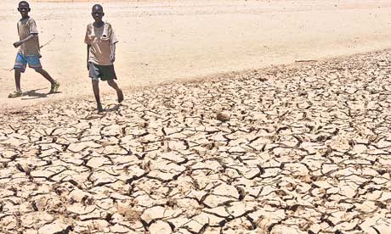
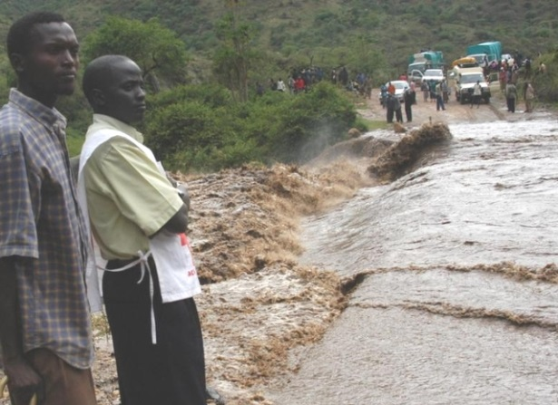
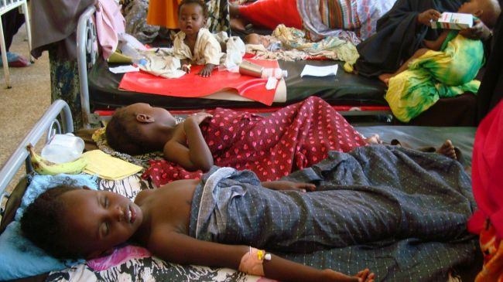
Flood/Drought, Disease Risk assessment
Too little Water Drought/water shortages
African countries suffer from poor infrastructure
Too much water
Floods, and diseases like
cholera

Slide 3
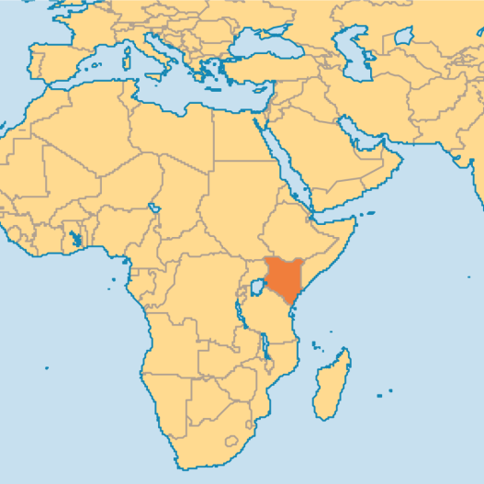
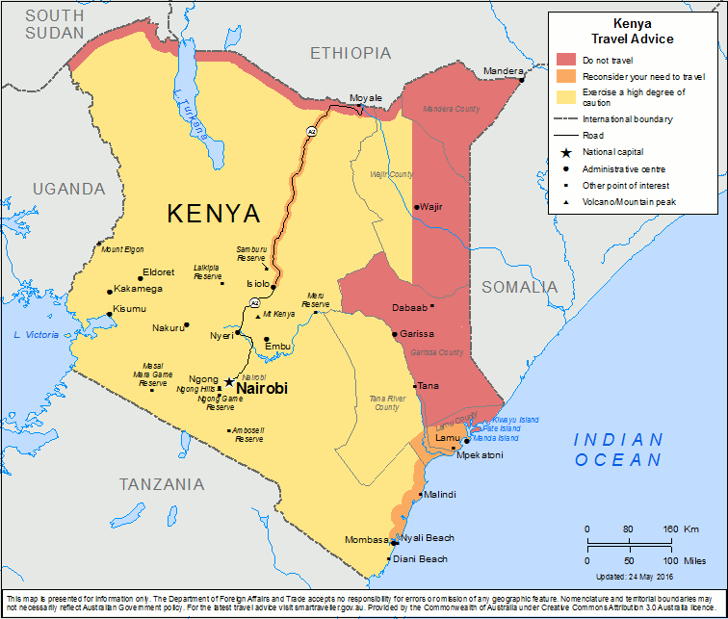
Big Data (historical + prediction) + Inference = risk
Data:
Spatial Population coverage/villages
Medical centres
Cholera cases (per region)
Rain Fall prediction
Rain Fall run off prediction
Poverty
Livestock
Accessibility to water
Drought/Flood index

Slide 4
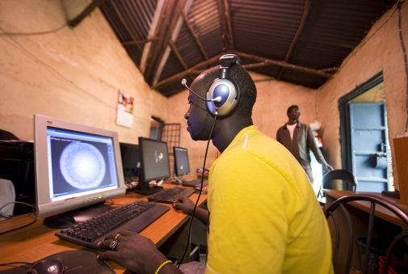
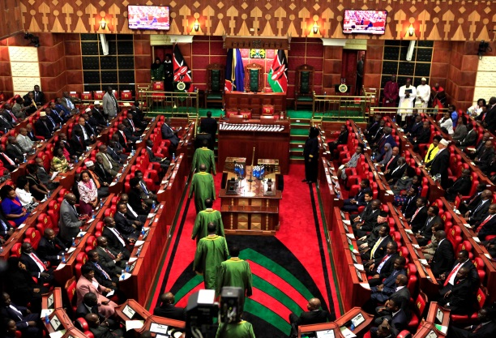
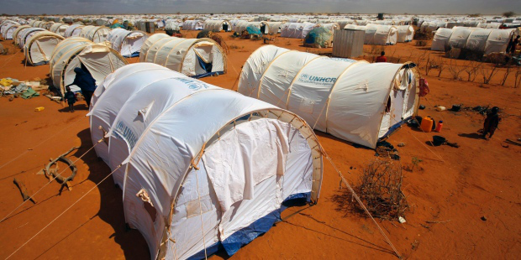
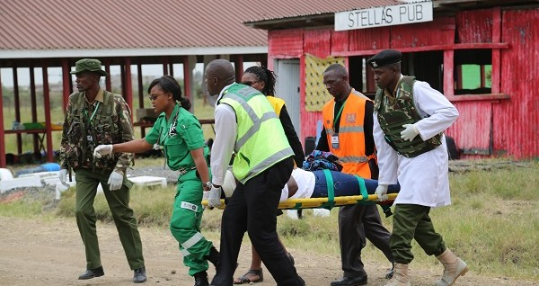
Users/uses
Users:
Locals
Emergency responses teams
Government planning
Uses:
Internet based
easily accessible (globally once on server, many systems)
updatable

Slide 5
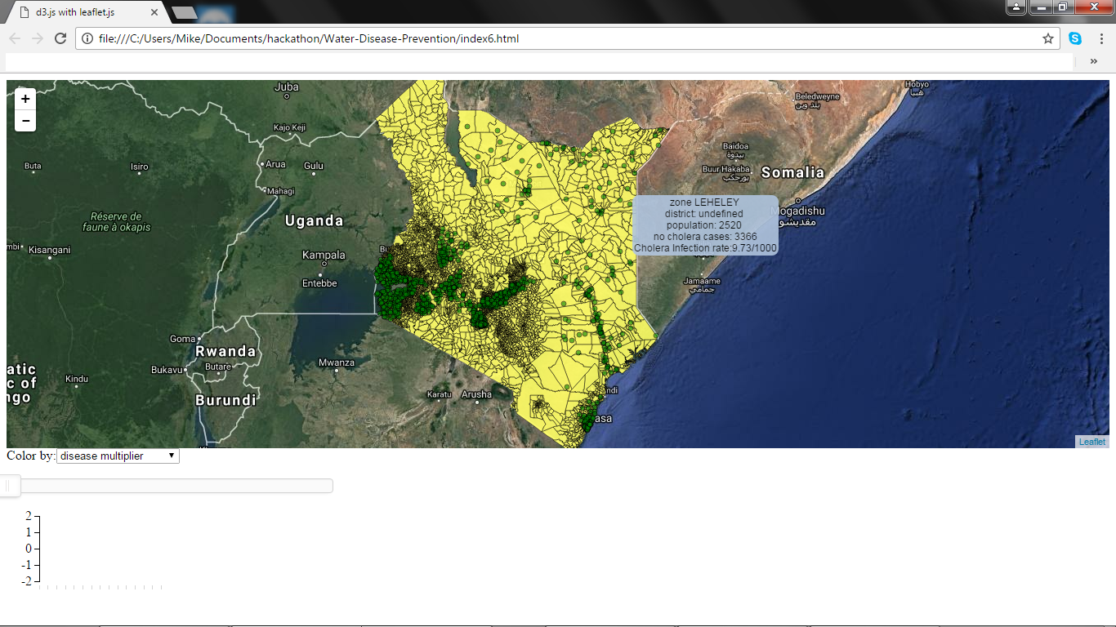
The system
https://github.com/MJGibson/Water-Disease-Prevention

Slide 6


Team – Centre for Water System PLUS Project – Water Disease Protection System Questions ???
5th March 2017
Dr. Michael. J. Gibson, Dr Albert Chen, Dr Barry Evans, Dr Mehdi Khoury, Dr Damien Decremer (plus)

Slide 7





Languages and systems used
Languages:
Java script / d3js, leaflet
Python
Fortran
Systems
ArcGIS/ArcMAP
QGIS

